Slide 1
Efood
Assessment
Efood
Customer Segmentation

Slide 2
Main Tasks
Database Creation
Create a Database from csv given by Efood
SQL Queries Creation
Based on the demands create two analytical queries.
Conduct Clustering Analysis
In order to find the customer segmentations.
Data Visualisation
Create a tool on Streamlite and PowerPoint demonstration.

Slide 3
Customers Allocation per Cuisine
Street Food
Breakfast
Quick cooked meals
Brunch meals
Meat
Italian
Meals with meat base
Spaghetti and pizza dishes
9%
39%
35%
17%

Slide 4
Customer Orders Once or More
More than One
Customers have ordered more than one number
42%
58%
One
Customers have ordered exactly one number

Slide 5
Customers Clusters Allocation
VIP
Average
Low Spend
Mean order Counts: 20,6
Mean amount: 185
Mean amount per order: 11
Mean order Counts: 8,5
Mean amount: 73,7
Mean amount per order: 11,1
Mean order Counts: 2,3
Mean amount: 18,9
Mean amount per order: 9,5
Higher Cluster
VIP
4%
Average
22%
74%
Low spend
74%

Slide 6
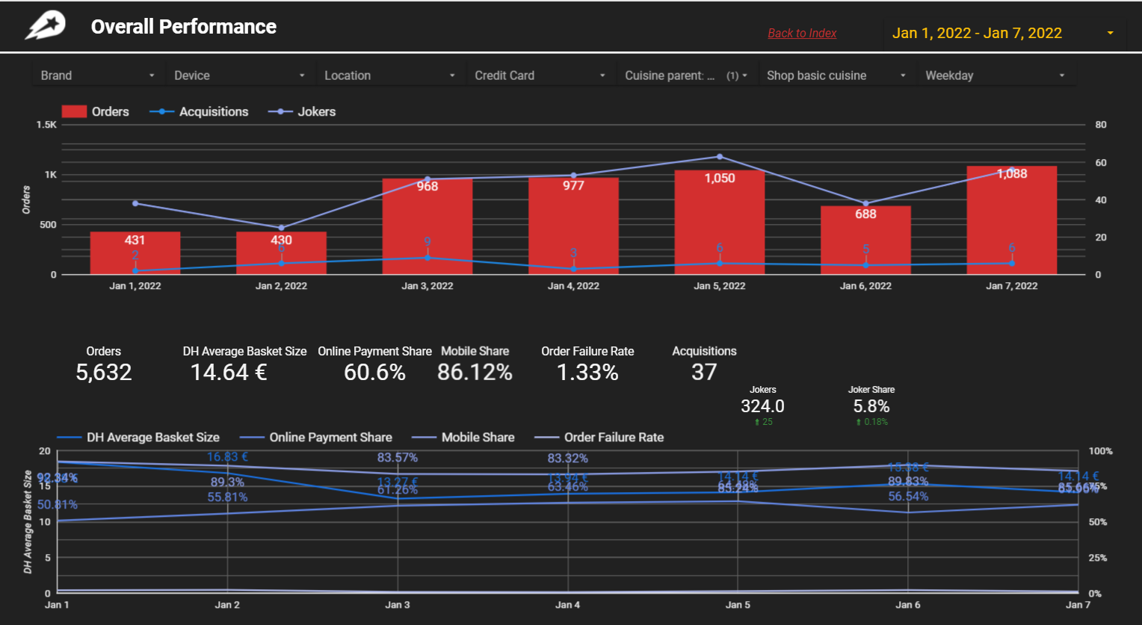
Efood Dashboards
Improvements
Joker metrics should be aligned with the other metrics
The lines on the histogram should be different color in order to distinguish the differences
Order Failure Rate line doesn’t really help no information
Outcomes
Weekly Dashboard
60% online orders
Over 80% from them through Mobile
37 new customers in a week

Slide 7
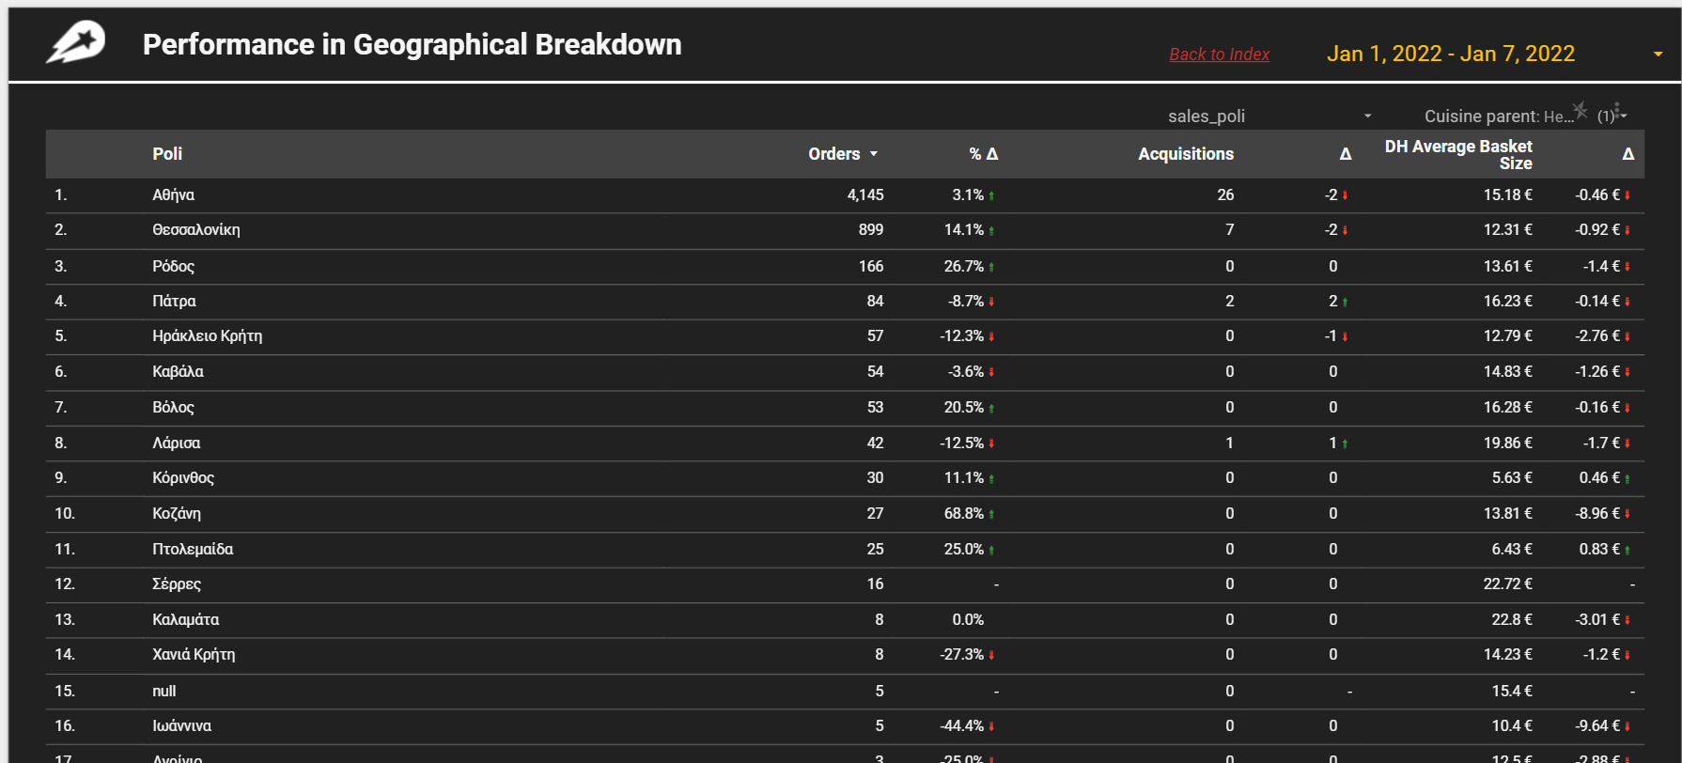
Improvements-Outcomes
Improvements
All Δ should have the same format (integers, percentages, euros), percentages
There is a null row that should be removed or fixed
If dashes indicate stability should be replaced with a left or right yellow arrow
Outcomes
Κοζάνη has the largest weekly growth over 60%
Σέρρες has the largest average basket size over 20 euros
Ιωάννινα has the greatest fall from previous week over 40%

Slide 8
Summary-Results
Results
BigQuery
Almost half of the customers have ordered only once and 40% order breakfast
Create database and Sql queries
Conclusion
Clustering Analysis
Efood
Project
Marketing Campaign should focus on Low spenders Group in order to rise the revenue and amount of loyal customers
Conduct Clustering Analysis so as to define Customer classes
Streamlite
Future Work
Build visualisation tool to depict the results
More demographic data for clustering and more graphs on streamlite

Slide 9
Thank You!
Efood
Full name: Akis Gazepidis
Title: Data Scientist
Email: akisgazepidis@gmail.com

